Slide 1
Improved Trust Worthiness in Electrical Energy
Management using K-means Augmented Blockchain Technology
(Olufade F.W Onifade, Babafemi G Sorinolu, Ayodeji O.J Ibitoye)
Presenting :
Babafemi G Sorinolu
3rd Biennial Conference on TOKI
(Transition From Observation To Knowledge To Intelligence)
15th to 16th August, 2019
New Engineering Lecture Theatre, University of Lagos, Nigeria

Slide 2
Outlines to be Covered
Introduction
Literature review
Research motivation
Our approach
Results
Conclusions
References

Slide 3
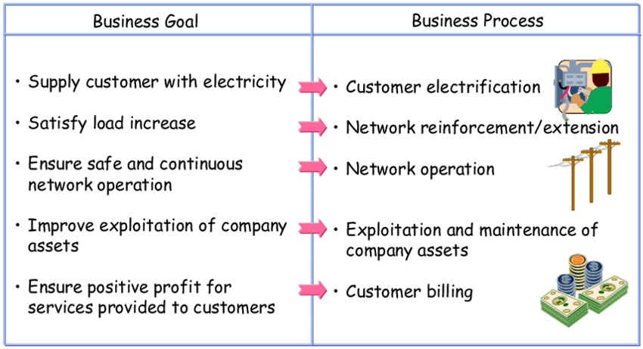
Introduction
The goals of an energy management organization can be categorized as
  Provision of value added services
  Generation of profits

Slide 4
Introduction (cont)
The expectations of electricity consumers include
  Delivery of satisfactory service
  Affordable billing rates for electricity usage
Do the goals align between the utility companies and the users in our environment ???

Slide 5
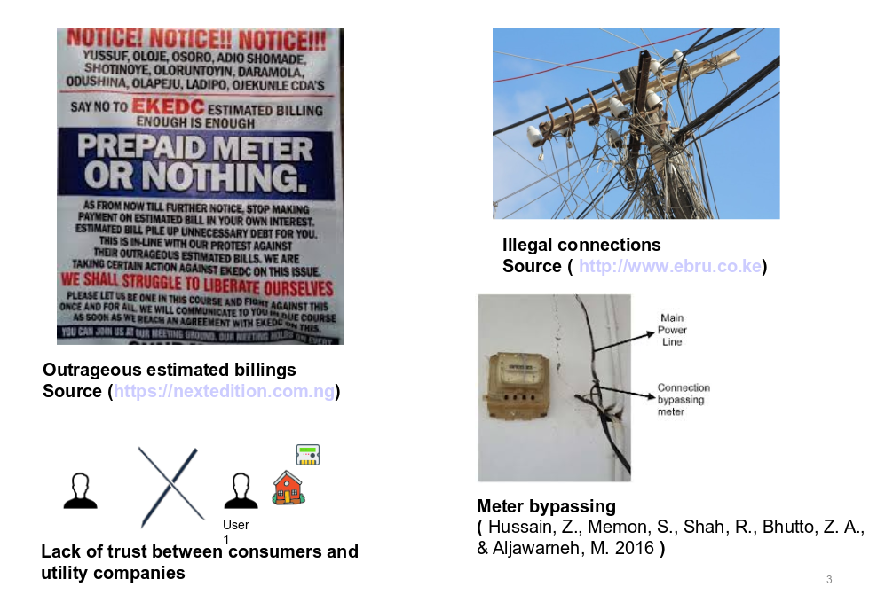
Introduction (cont)

Slide 6
Literature review
TOPIC AND AUTHOR | SOURCE AND YEAR | CONTRIBUTION
BITCOIN : A PEER TO PEER ELETRONIC CASH SYSTEM. (Nakamoto, 2008) | Bitcoin.org, 2008 | This paper introduced the concept of bit coin and blockchain. It also explained the workings behind the Proof of work consensus algorithm.
Blockchain technology in the energy sector : A systematic review of challenges and opportunities (Andoni, et al, 2019) | Renewable and Sustainable Energy review, 2019. | This paper reviewed 140 blockchain research projects and startups and highlighted the potentials of blockchain in the energy sector
GridMonitoring: Secured Sovereign Blockchain Based Monitoring on Smart Grid. (Gao, et al., 2018) | IEEE Access, 2018 | This paper proposed a smart-grid which uses blockchain to ensure a secure record management.
An E-voting Protocol Based on Blockchain.(Liu & Wang, 2017) | IEEE Access, 2017 | This paper uses the properties of blockchain to model an e-voting system that will be secured from external manipulations

Slide 7
Research Motivation
Address the perceived notion of unsatisfactory service delivery
Enhance customer confidence
Data analytics

Slide 8
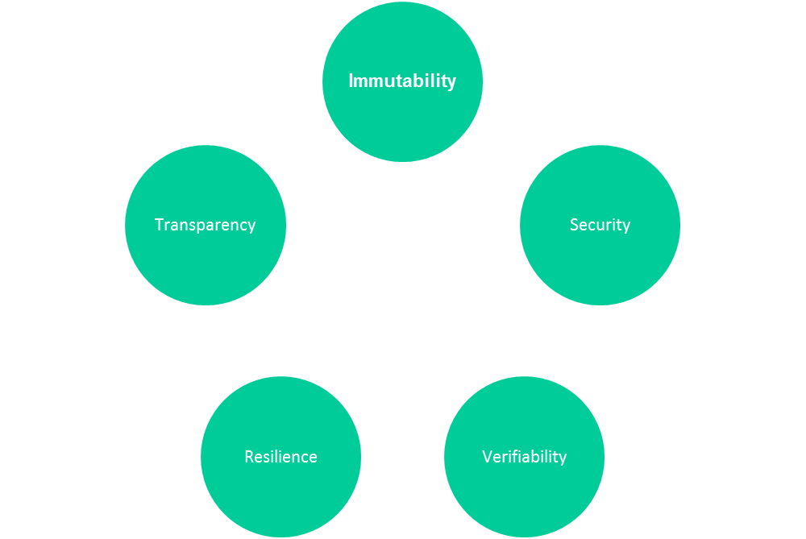
Project motivation- solutions
Blockchain technology
Machine learning

Slide 9
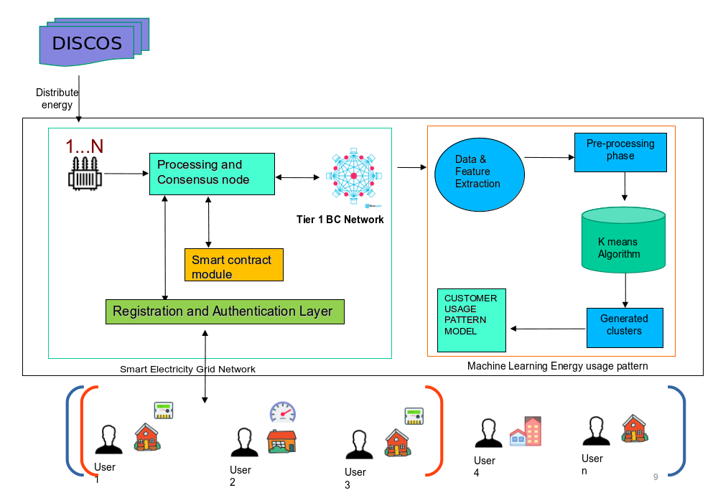
Our Approach: Data collection/aggregation phase:

Slide 10
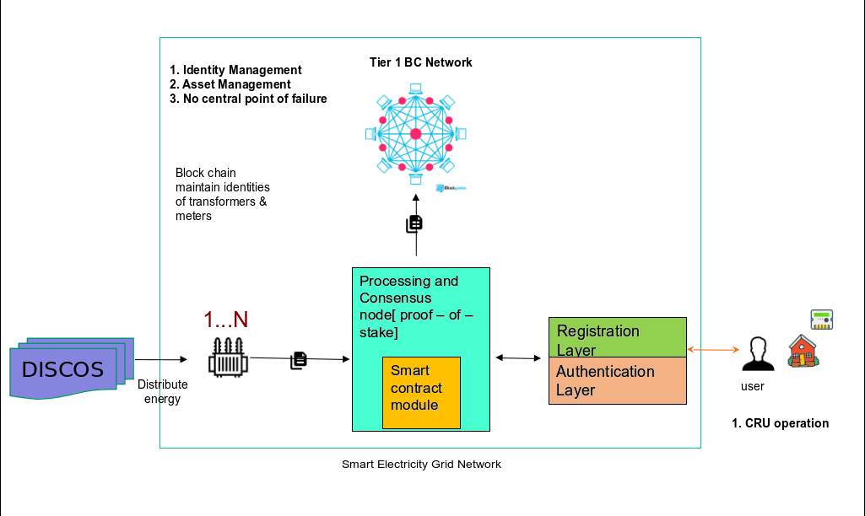
Our Approach (cont)

Slide 11
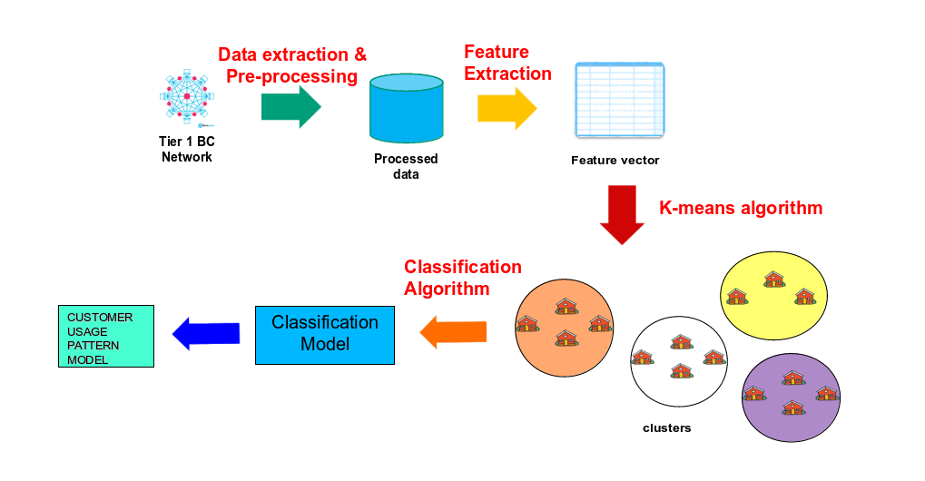
ML phase

Slide 12
Results
This model was experimented on the Ethereum blockchain framework.
2362 consumers’ daily electricity data between July 2009 and April 2010 considered for the scope of the work

Slide 13
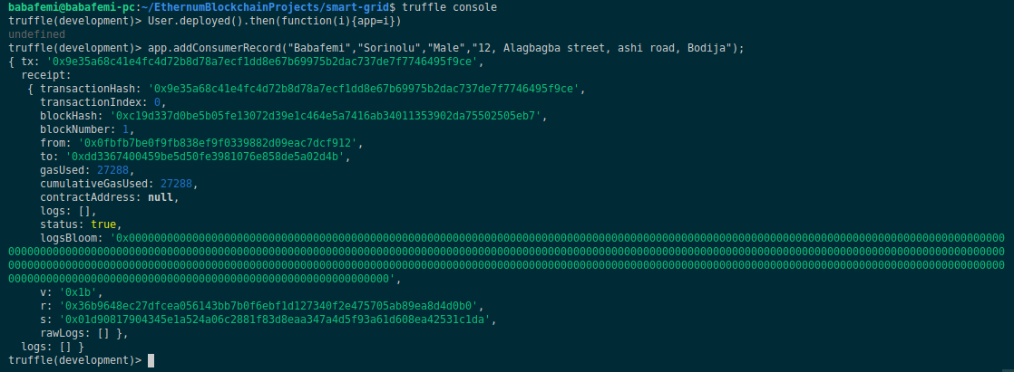
Results- Identity management

Slide 14
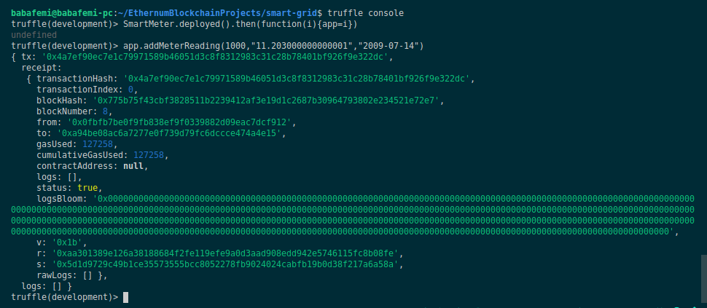
Results- Meter readings

Slide 15
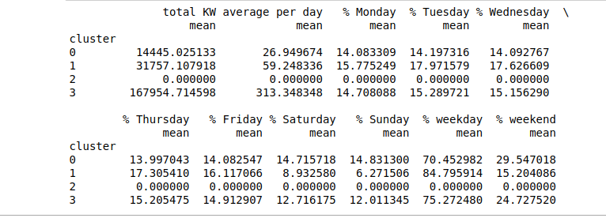
Results- Clustered users

Slide 16
Conclusion
This study showcased the capability of combined blockchain technology with k-means algorithm in effectively eliminating
  Energy theft
  Over-billings
  Enhanced trust among consumers and the service providers
  Intelligent usage reportings

Slide 17
References
Onakoya, A. B., Onakoya, A. O., Jimi - Salami, O. A., &
Odedairo, B. O. (2013). Energy Consumption and Nigerian
Economic Growth: An Empirical Analysis. European
Scientific Journal, 9(32), 25–40.
Rapu, C. S., Adenuga, A. O., Kanya, W. J., Abeng, M. O.,
Golit, P. D., Hilili, M. J., ... Ochu, E. R. (2015). Analysis of
Energy Market Conditions in Nigeria. Retrieved

Slide 18
References
Miraz, M. H., & Ali, M. (2018). Applications of Blockchain Technology beyond Cryptocurrency, 2(1), 1–6.https://doi.org/10.33166/AETiC.2018.01.001
Brilliantova, V., & Thurner, T. W. (2018). Blockchain and the future of energy. Technology in Society, 57(1), 38–45.

Slide 19
References
Andoni, M., Robu, V., Flynn, D., Abram, S., Geach, D.,
Jenkins, D., ... Peacock, A. (2018). Blockchain technology
in the energy sector: A systematic review of challenges and
opportunities. Renewable and Sustainable Energy Reviews,
100(February 2018), 143–174.
Gao, J., Asamoah, K. O., Sifah, E. B., Smahi, A., Xia, Q., Xia, H., ... Dong, G. (2018). GridMonitoring: Secured Sovereign Blockchain Based Monitoring on Smart Grid. IEEE Access, (March), 9917–9925.
https://doi.org/10.1109/ACCESS.2018.2806303

Slide 20
Thank you for your attention

